Slide 1
What is coming in RPM apps
Updated March 19, 2026

Slide 2
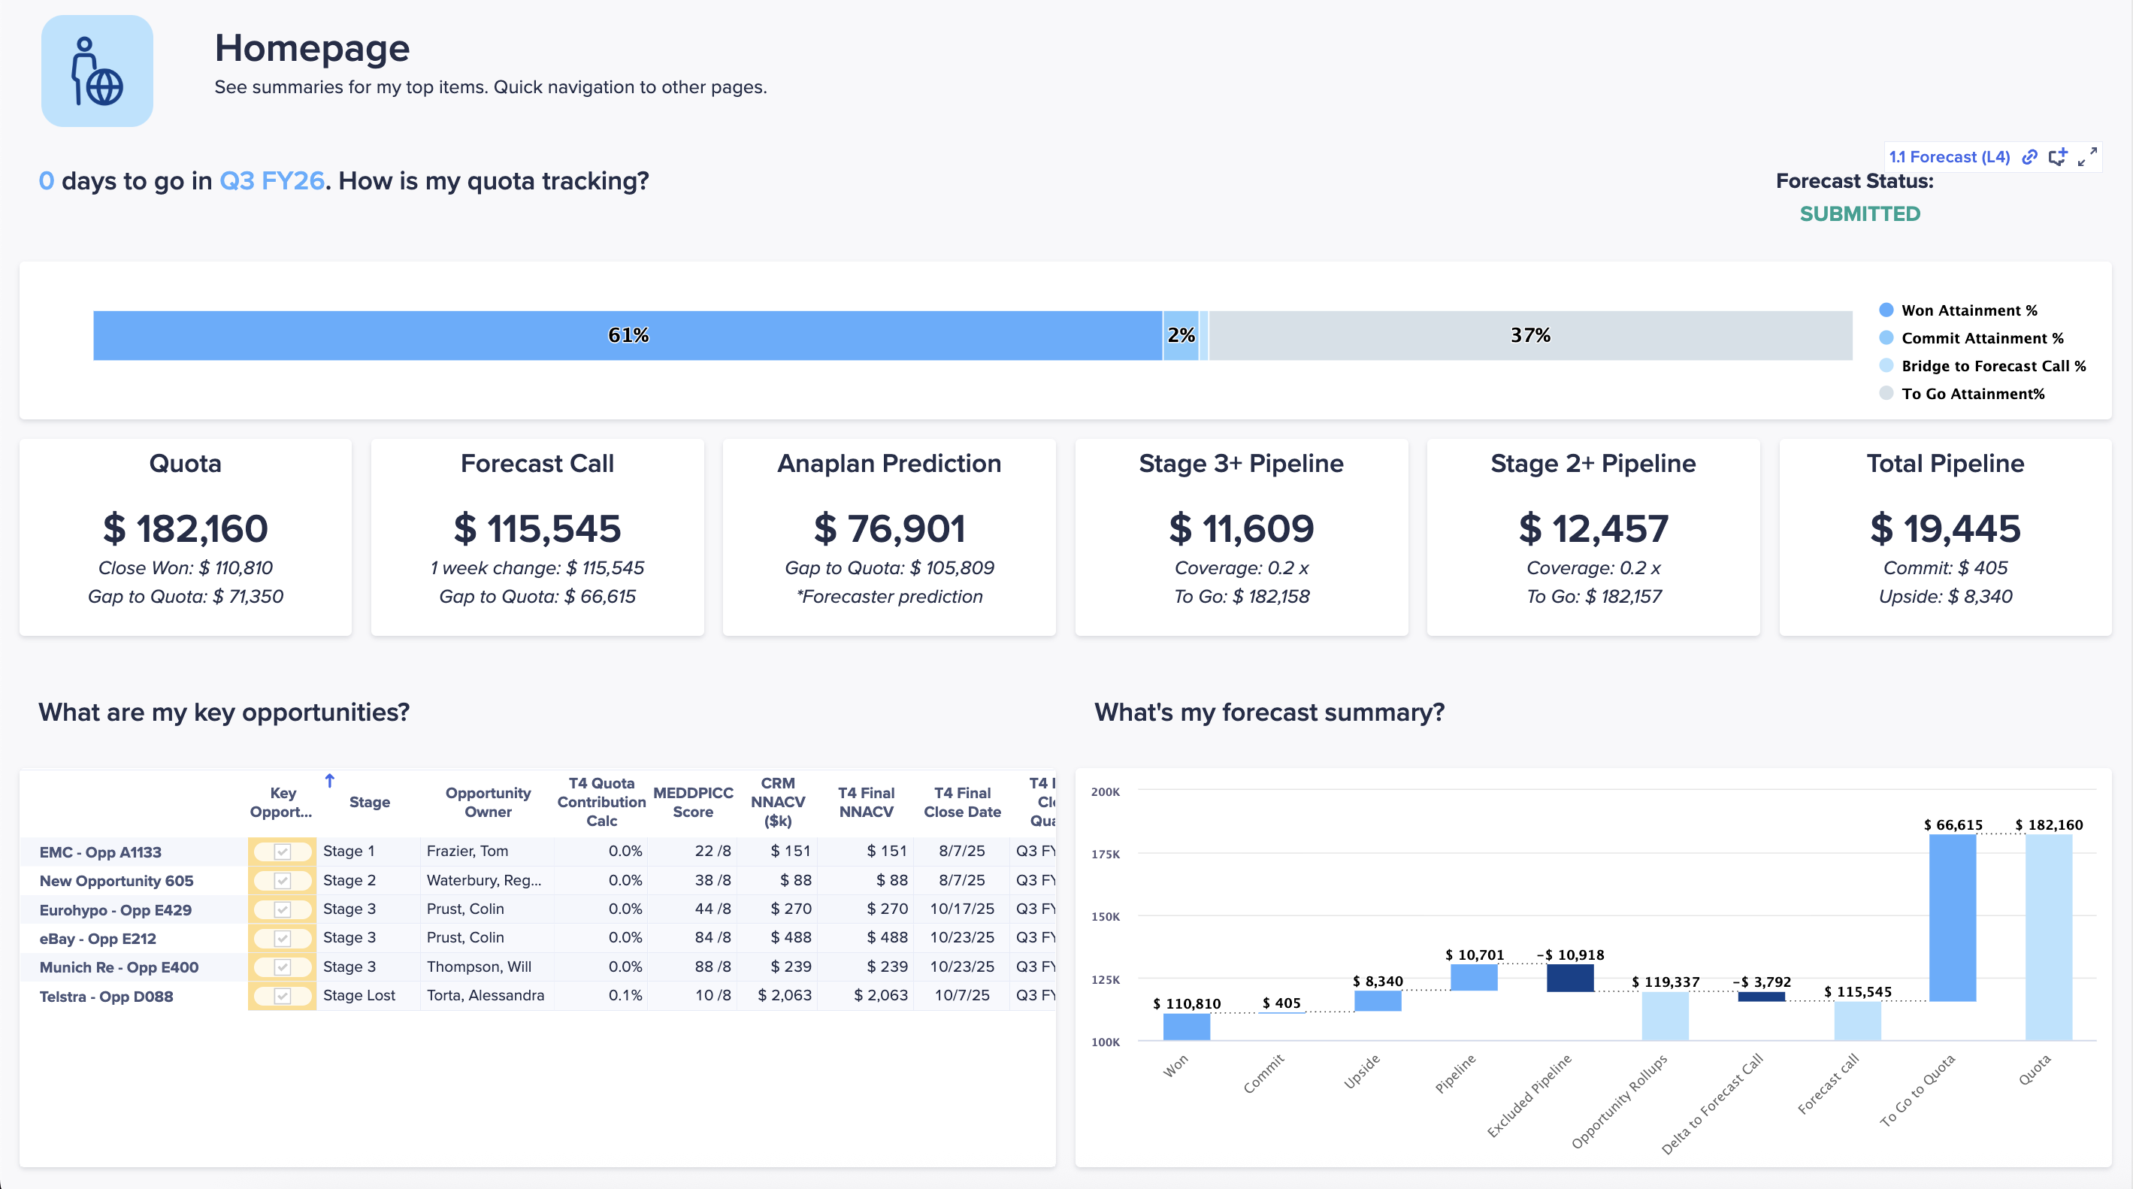
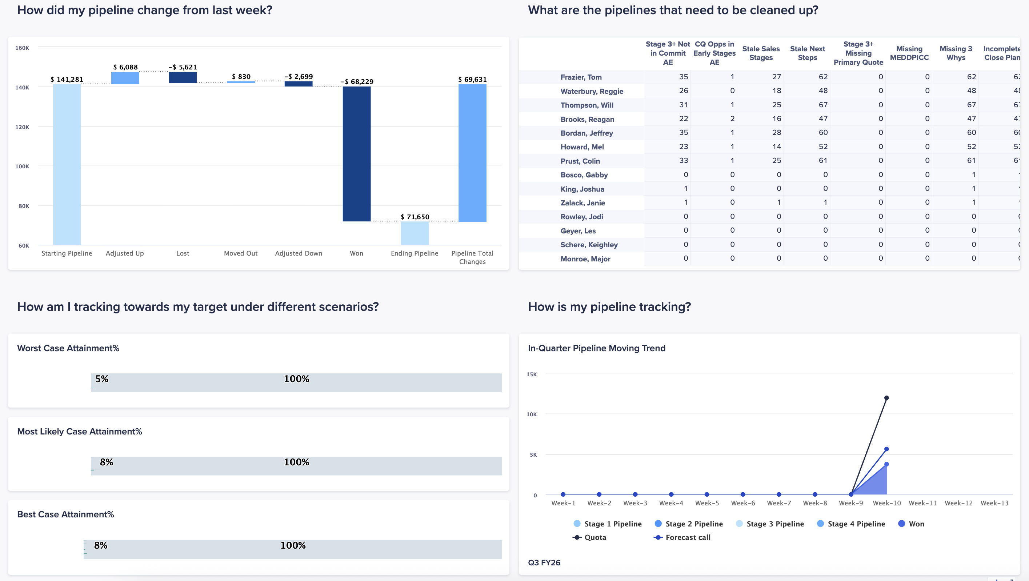
Sales Forecasting (Launching at NY connect)
Out-of-the-box functionalities to support forecasting, pipeline, accounts, and insights
Forecast:
Forecasting and Performance: Submit and analyze individual and team-level forecasts, tracking performance against quotas and historicals
Opportunity Management: providing a high-level summary of the sales pipeline and allows users to drill down into the details of individual deals, such as product information, qualification status, and closing plans.
Scenario Planning: Utilize interactive dashboards to build and compare different forecast scenarios (e.g., "Worst," "Most Likely," and "Best Case") to understand potential outcomes and inform strategic planning.
Pipeline:
Pipeline Analysis designed to track the health and progress of the sales pipeline against set targets. Provides multi-quarter view of the pipeline and key metrics for various sales stages.
Pipeline Generation tracks the creation of new sales opportunities against targets. Providing a detailed breakdown of generation momentum allowing users to monitor their performance.
Pipeline Hygiene: identifies sales opportunities that have data quality issues or require immediate action. Allowing sales teams to quickly clean up their pipeline data for more accurate forecasting.
Analytics showing the sales pipeline has changing over a specific, user-defined period. Allowing for a deep analysis of pipeline dynamics.
Account:
Growth Opportunity: Identify upsell and cross-sell opportunities by analyzing "white space" (unsold products) and tracking the complete history of all sales and marketing engagement with a customer making it easy to spot and prioritize growth areas within an account.
Insights:
Historical Performance: Review historical business performance with dashboards that visualize key trends, win/loss reasons, and pipeline conversion rates, enabling leaders to understand and improve sales outcomes.
Channels:
Channel Performance: Monitor and analyze the business performance of sales partners with both high-level overviews and detailed drill-downs into key metrics.
Product Performance: Analyze sales from a product-centric perspective, providing overviews across all product families and enabling deep-dives.

Slide 3

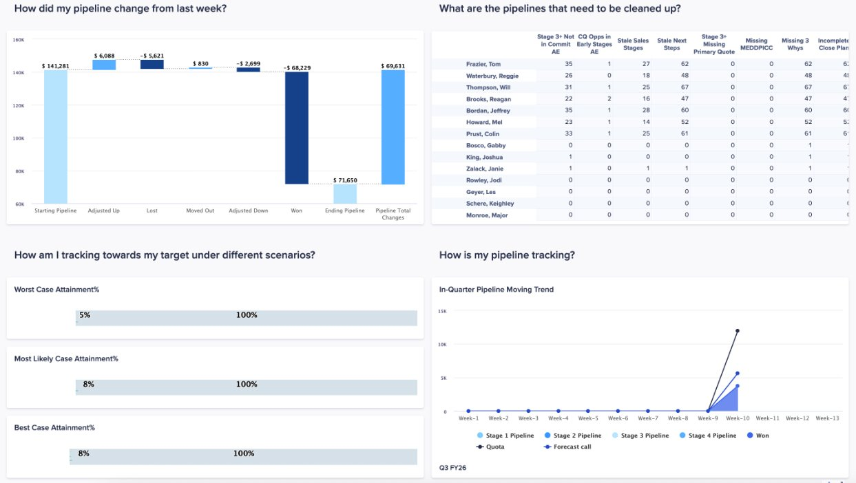
Sales Forecasting Application Showcase
Forecasting
Pipeline Analytics

Slide 4



Existing Application updates(May 2026)
Territory and Quota Planning Application v3
Account Segmentation and Scoring v2
GTM Capacity Planning v2
Classic to Polaris Upgrade
Improved core TnQ functionalities (Split account, Target override, resource assignment)
Improved rule engine and optimizer connection
Improved GTM hierarchy planning capabilities
Improved tops down HC planning views
Robust ramp modeling

Slide 5




Territory and Quota Planning V3
Foundation for AI Capabilities
With TnQ moving to Polaris, it unlocks the compatibility to Anaplan’s Agent Studio and Co-modeler usage for the model
ADO Compatibility
No more Datahub, unleash next-gen data integration capability
Robust account to territory functionality
Optimizer, assignment rule engine, zip-code mapping, split account management, one to many assignments and even bulk upload for your spreadsheet stragglers
Improved core T&Q functionality
Resource assignments/ target override / scenario planning
Notes:
Reduce Limitation
Performance / Scalability
New Features
Long-term Positioning (Future Proof)
Improved support for granular target/quota setting
Foundation for AI capabilities(Sales Analyst / Co-Modeler)
Similar/Same workflow UX experience for end-users
Functionality Parity*

Slide 6
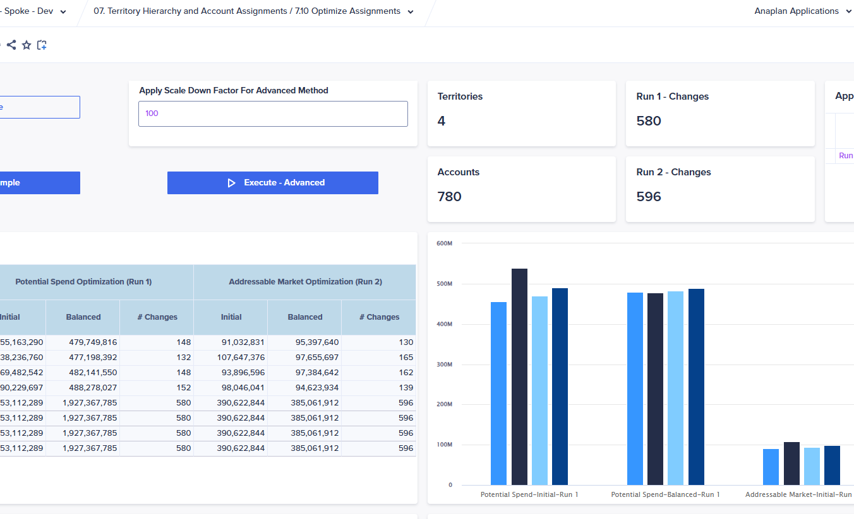
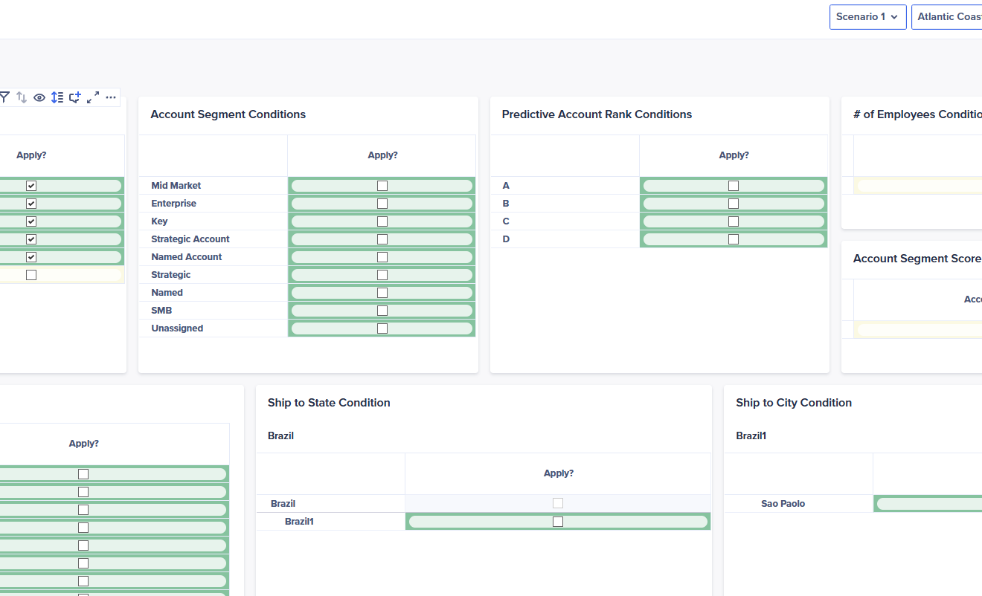
TnQ v3 Application Showcase
Territory Optimizer
Account Assignment Rule Engine

Slide 7


What's Coming to Segmentation V2 – Enhanced GTM Modeling
In
Setup Hierarchy Viability
Create Planning Hierarchy
Create Rule Definitions
Assign Rule to Account
Resolve Rule Conflicts
Select Final Scenario
Out
Account Data
Opportunity and Order Data
Account to Planning Territory Mapping
User input
User input
User input
Cal based
User input
User input
Confidential

Slide 8
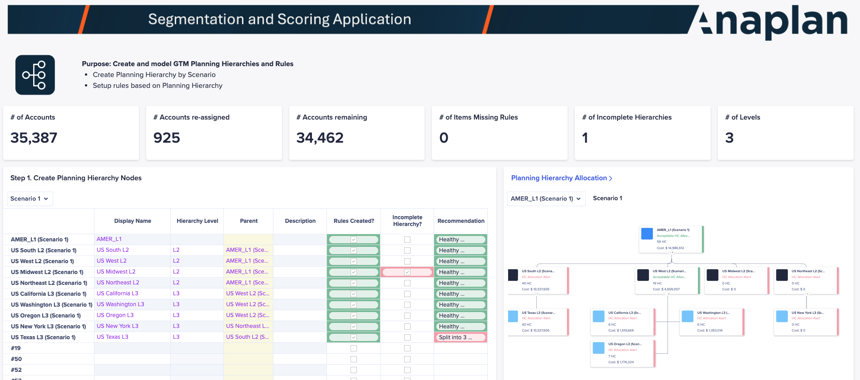
GTM Modeling – Key Screens
5.1 GTM Modelling
Setup GTM Planning Hierarchy
Setup GTM Planning Hierarchy Rules
Select Rule Definition
Confidential

Slide 9
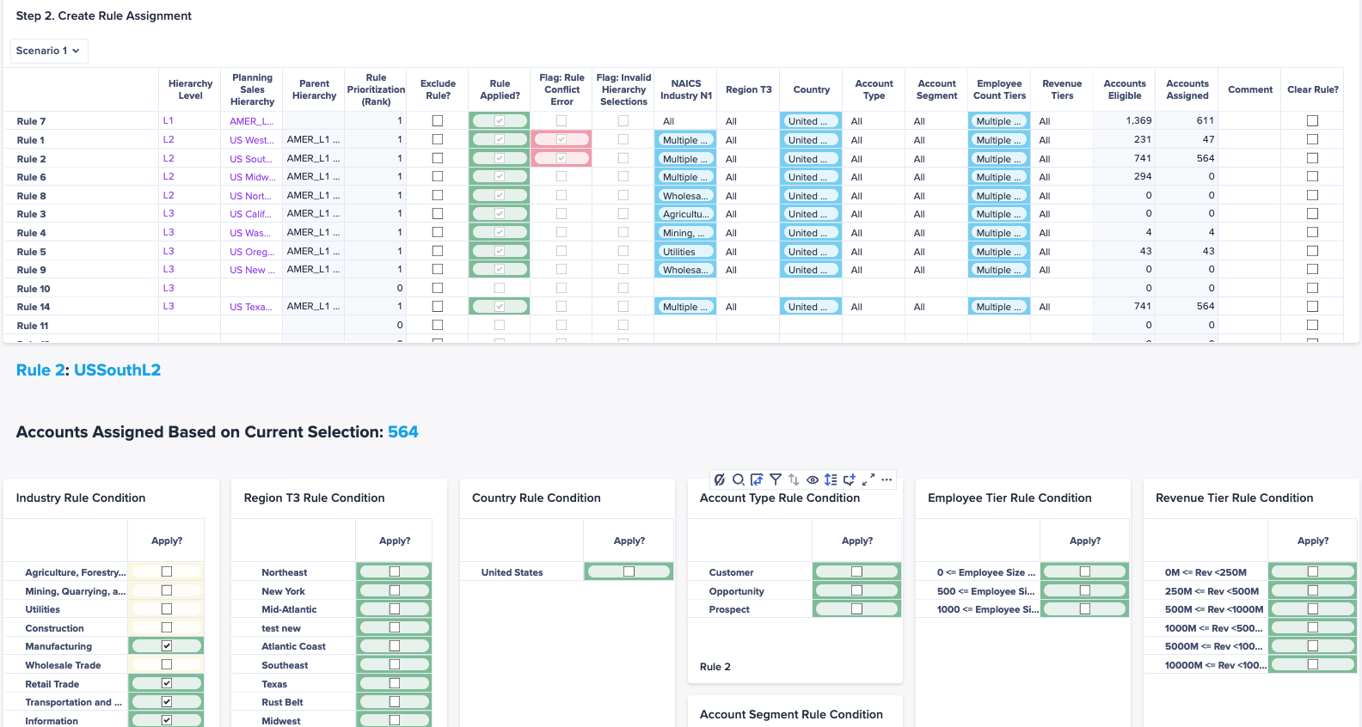
GTM Modeling – Key Screens
5.1 GTM Modelling
Setup GTM Planning Hierarchy
Setup GTM Planning Hierarchy Rules
Select Rule Definition
Confidential

Slide 10
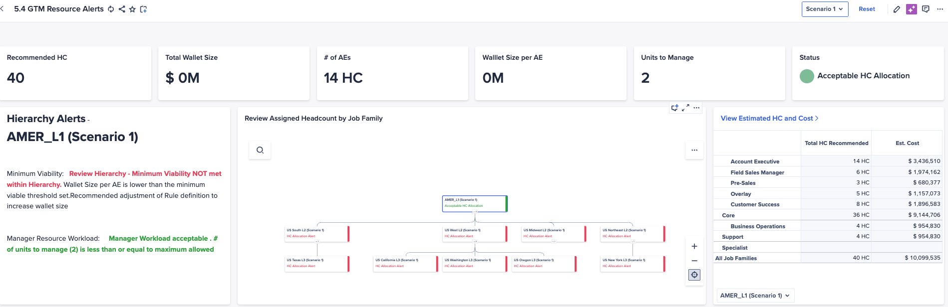
GTM Modeling – Key Screens
5.4 GTM Resource Alerts
Review high-level suggested headcount for proposed GTM hierarchy
Resolve alerts on workload imbalance
Confidential

Slide 11
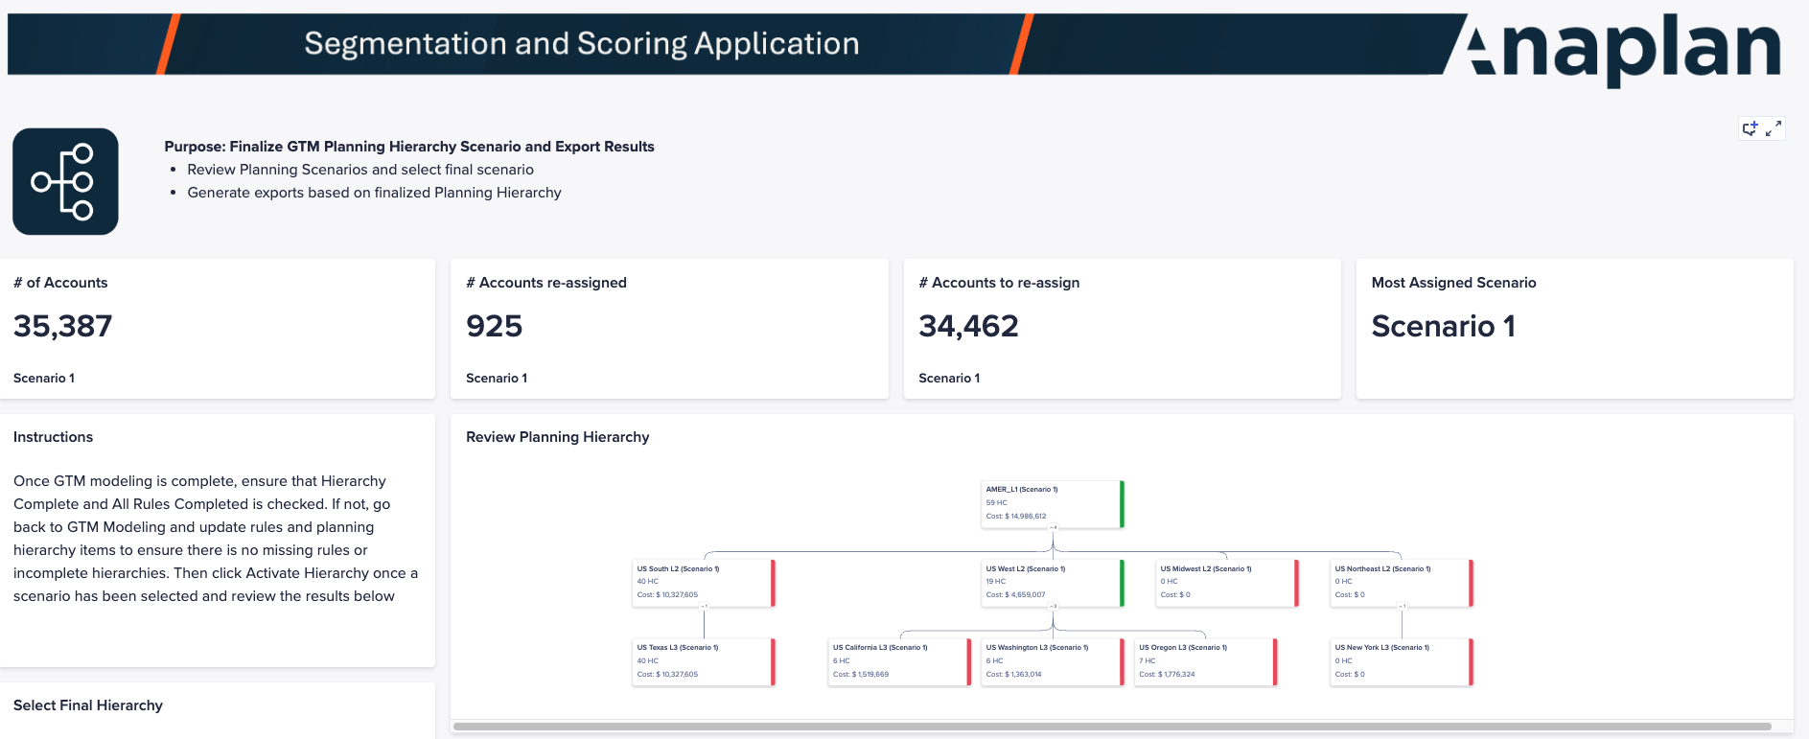
GTM Modeling – Key Screens
5.7 Finalize GTM Hierarchy
Review GTM Hierarchies by Scenario
Select and Finalize Scenario
Export new Account to Territory Hierarchy
Confidential

Slide 12
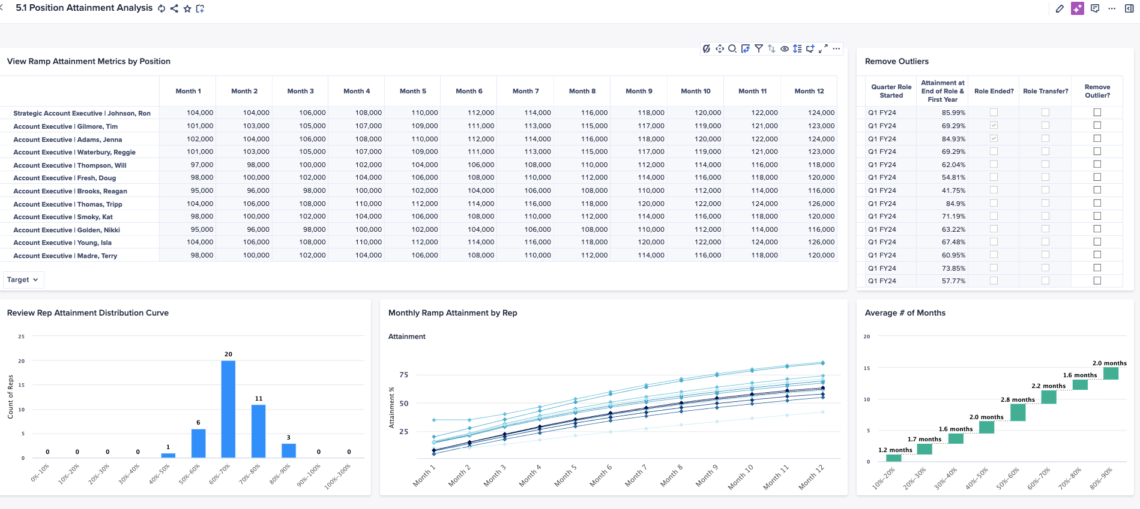
What's Coming to Capacity V2 – Ramp Modeling
Review historical ramp / attainment data
Confidential

Slide 13
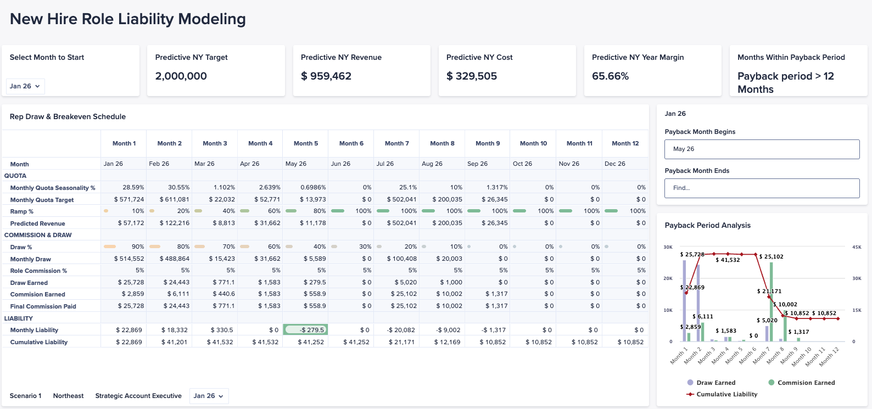
What's Coming to Capacity V2 – Ramp Modeling
Model breakeven for seasonal hiring
Confidential

